Slide 1
Information Extraction
Day 2

Slide 2
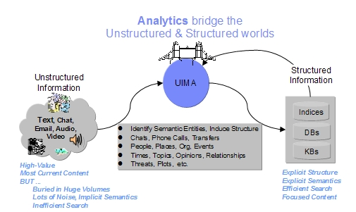
What is UIM ?
Unstructured Information Management
A wide topic: text, audio, video Different (possibly mixed) approaches (NLP, Machine Learning, IR, Ontologies, Automated reasoning, Knowledge Sources)
Apache UIMA

Slide 3
NLP & Apache UIMA

Slide 4
UIMA OVERVIEW :
UIMA stands for Unstructured Information Management Architecture and is a component architecture and software framework implementation for the analysis of unstructured content like text, video and audio data
The major goal of UIMA is to transform unstructured information to structured information by orchestrating analysis engines to detect entities or relations and thus to build the bridge between the unstructured and the structured world
The UIMA architecture can be thought of in four dimensions:
It specifies component interfaces in an analytics pipeline.
It describes a set of Design patterns.
It suggests two data representations: an in-memory representation of annotations for high-performance analytics and an XML representation of annotations for integration with remote web services.
It suggests development roles allowing tools to be used by users with diverse skills.

Slide 5
UIMA Data Structures

Slide 6
Common Analysis Structure (CAS)
Provides access to primary data
Stores secondary data aka annotations
Functions like an in-memory database
Annotation types are like “tables”
There are “indexes”

Slide 7
Type System
UIMA specification is platform-independent
Cannot rely on type system of implementation language (Java, C++)
UIMA provides an “Object-oriented” type-system with
Type -> class
Feature -> class member
Feature Structure -> instance
Single inheritance
Sub-type polymorphism
no methods or encapsulation
Primitive types: integer, float, boolean, string
Built-in complex types: arrays, lists, Annotation
Type-system forms communication contract between components

Slide 8
Typical NLP pipeline with Apache UIMA

Slide 9
Sample scenario – extract Persons
I have a dictionary of names (simple to find and/or build)
I use a dictionary based Annotator to extract annotations of first names (NameAnnotation)
I don’t have a dictionary of surnames
Everytime a matching name (a NameAnnotation) is found we look for one or
more (considering persons with double name or surname) subsequent tokens whose PoS is “undefined” or a noun (but not a verb) and starts with Uppercase letter
If found then the name + token(s) sequence annotates a Person (i.e. “Michael J. Fox”)

Slide 10
Sample Scenario – extract Actors
Tokenize article text
Identify sentences
Tag PoS
Identify Persons using regular expressions and PoS
Use Person annotations, Tokens’ PoS and Sentences to extract relations between terms to identify
Persons who are also Actors

Slide 11
Using UIMA
Define TypeSystem
Define AnalysisEngine descriptor(s)
Implement Annotator(s)
Execute the UIMA pipeline

Slide 12
1. Define TypeSystem
Define at least a Type inside Type System for each object inside the domain model
Useful to define more fine grained Types (for values of type properties, called Features)
If we want to extract information about articles we create an Article type inside the Type System
Also we’ll need to create annotations/entites for movies,actors, directors, etc...

Slide 13
//TypeSystem screenshot

Slide 14
2. Define AnalysisEngine descriptor
Define which type system it’s going to use
Define which capabilities the analysis engine has: which annotations
need to work and which annotations it’ll (eventually) generate
Define configuration paramaters for the underlying algorithm
Define resources needed by the analysis engine

Slide 15
//Analysis Engine Descriptor file

Slide 16
3. Implement Annnotator
create a new class extending JCasAnnotator_ImplBase
implement the process() method that actually does the job
the algorithm implementation is (called) in the
process() method
you can use configuration parameters/resources defined in the descriptor
eventually override initialize() and destroy() methods

Slide 17
//Code snippet for Annotator

Slide 18
4. Execute UIMA pipeline
Instantiate the AnalysisEngine with its descriptor as a parameter
Create a CAS which will contain the text to be analyzed and the annotations extracted
Run the AnalysisEngine on the given CAS
Browse results

Slide 19
//UIMA pipeline code snippet

Slide 20
What’s next
Hands on code (assignment)

Slide 21
Thank you

